Slide 1
Cairn Alumni Application User Training
by Tyler Carrier

Slide 2
Alumni User Training

Slide 3
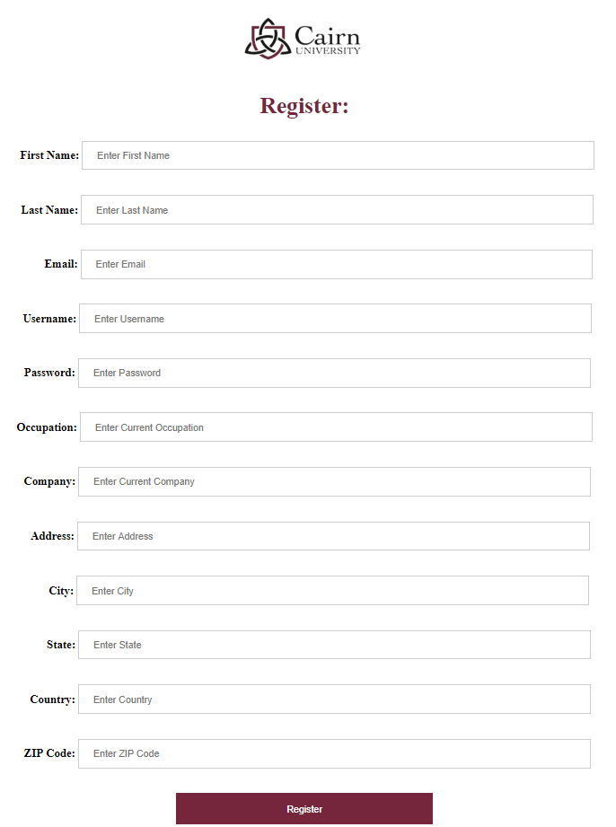
Register Alumni User
Students must first fill out registration form. This information will be able to be accessed later on.

Slide 4

Login
Once your account is registered, you can then access your account via the login page. This is the first page you will be directed to.

Slide 5
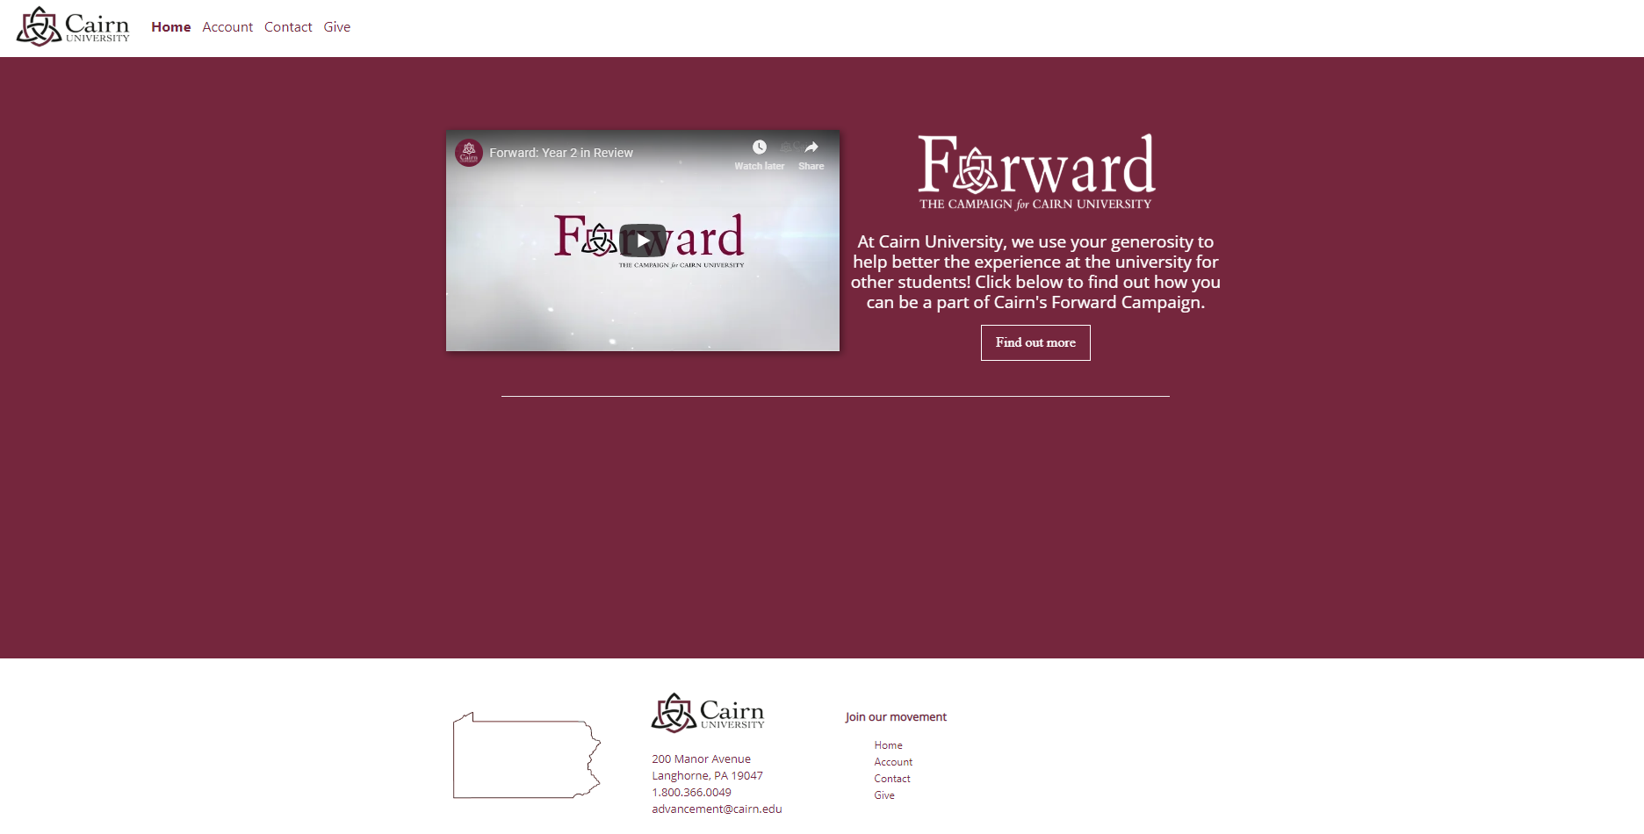
Home Page
The first page you will be directed to after login is the home page. Here, you will find information on Cairn’s Forward campaign. Click “Find out more” to learn more about it.

Slide 6
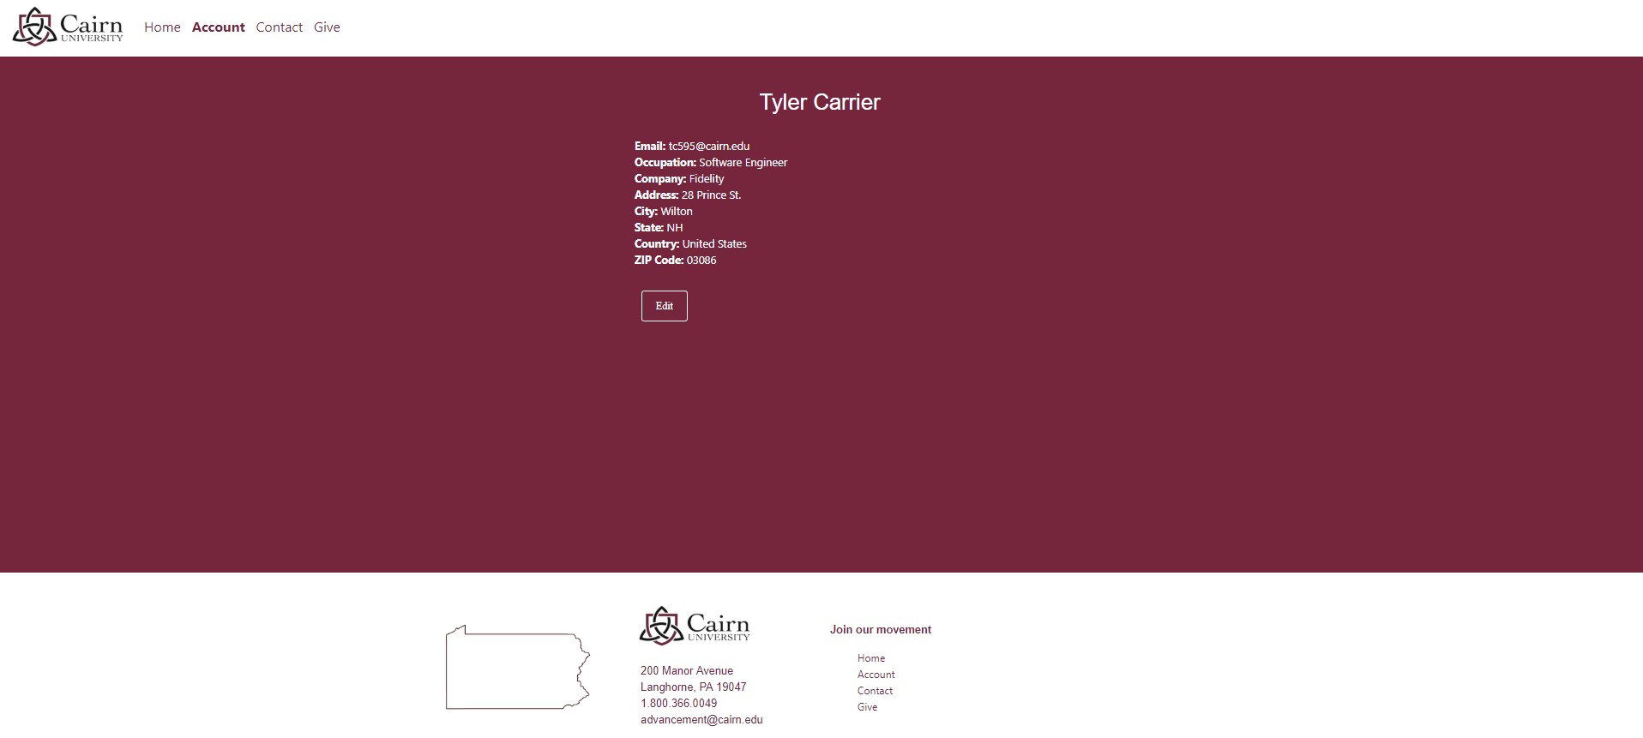
Profile Page
This is your basic profile page which will give you access to all information you previously entered. Here you can view and edit your info.

Slide 7
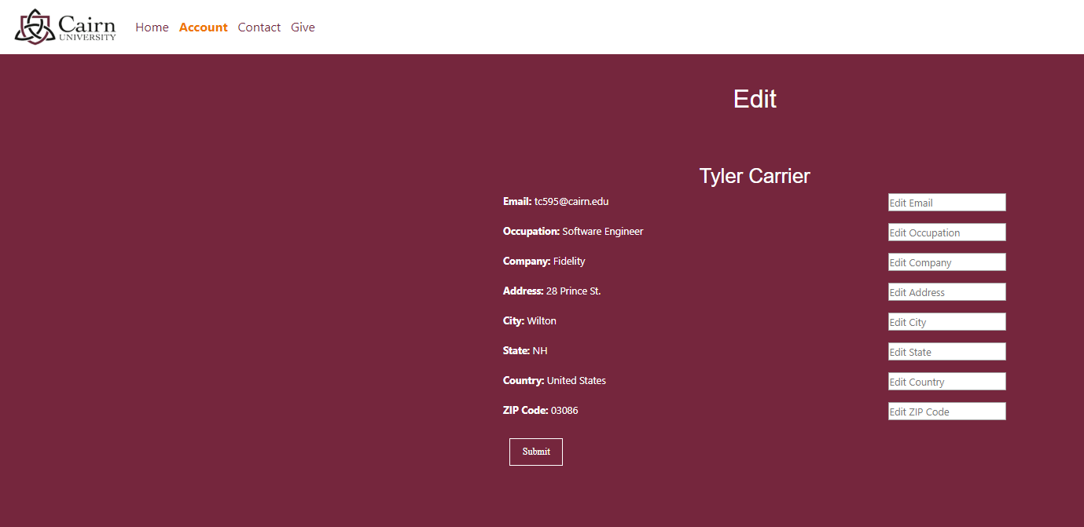
Edit Profile Info
By clicking the edit button you will be able to update all info you previously entered.

Slide 8
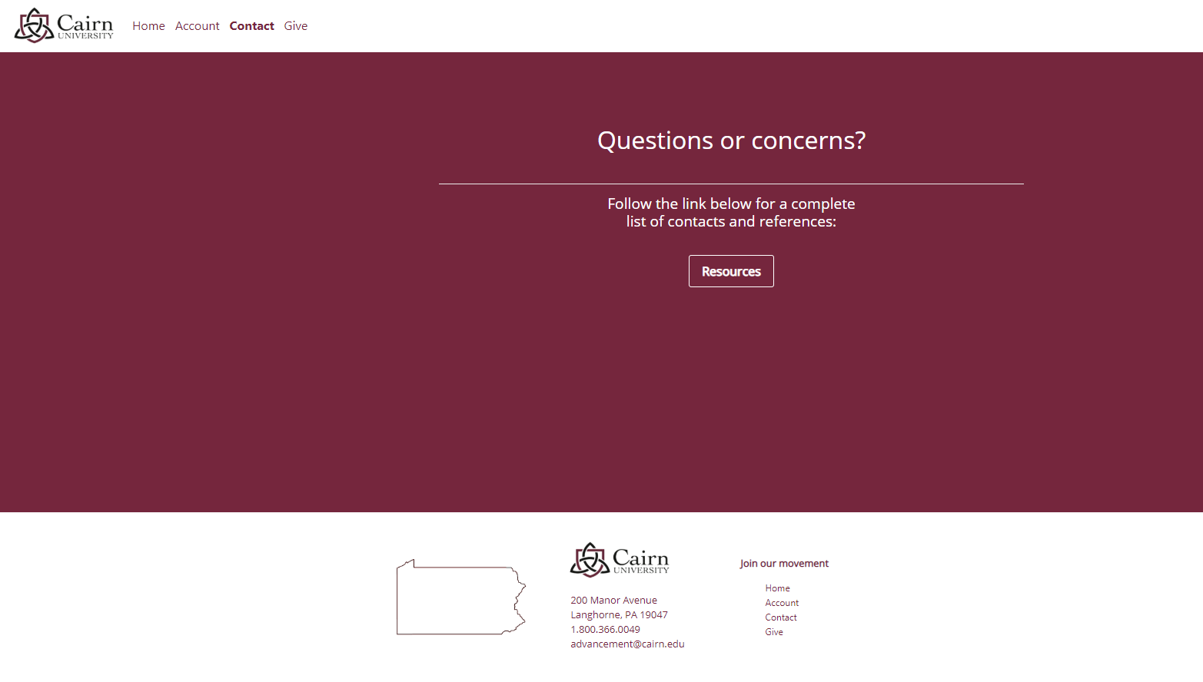
Contact
Cairn University
Click the “Resources” button on the Contact Page to be directed to Cairn University’s website for a full list of resources.

Slide 9
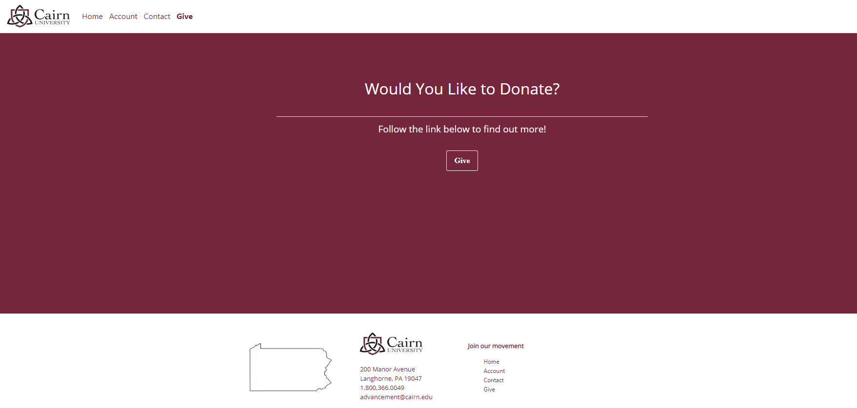
Give to
Cairn University
Click the “Give” Button to be directed to Cairn University’s donation page where you can learn more about the Forward Movement and make donations.

Slide 10
Faculty User Training

Slide 11
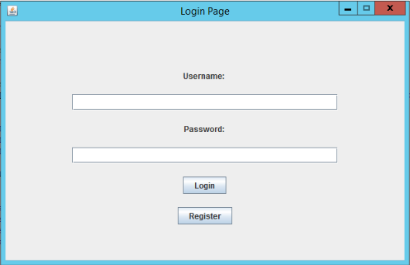
Faculty Login Page
This is the basic login page. The register button will direct the user to the online Faculty Registration Page.

Slide 12
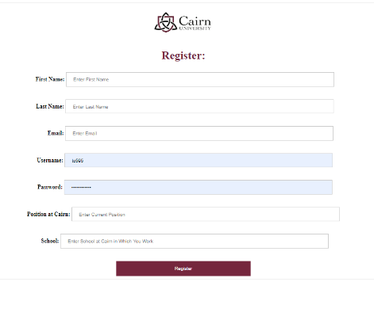
Faculty Registration Page
This is the basic registration page which takes the basic information in about the faculty member.

Slide 13
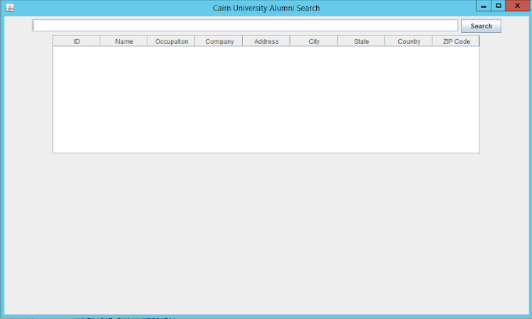
Alumni Search Page
Here, you can search any desired information, and all relevant information will load on to the table below

Slide 14
Purpose of Cairn Alumni Application
Gain interest from disconnected alumni
Create a means of constant interaction with alumni
Gain donations
Encourage interaction from with students from the alumni

Slide 15
Future of Cairn Alumni Application
More customizable content
Interactive pages for alumni entertainment
Constant stream of alumni news and events to be displayed on website

